Slide 1
output
2023-B071-30763

Slide 2
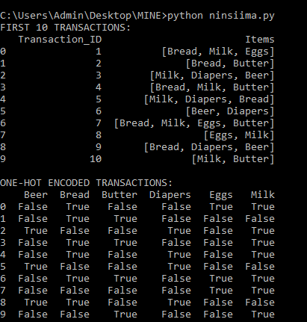
PART A: DATASET TRANSACTION

Slide 3
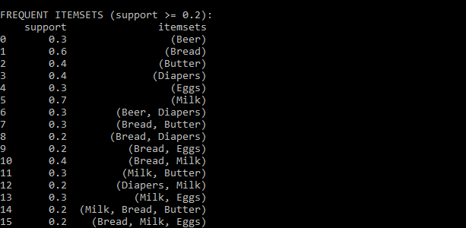
PART B: APRIORI ALGGORITHM FREQUENT ITEMS

Slide 4
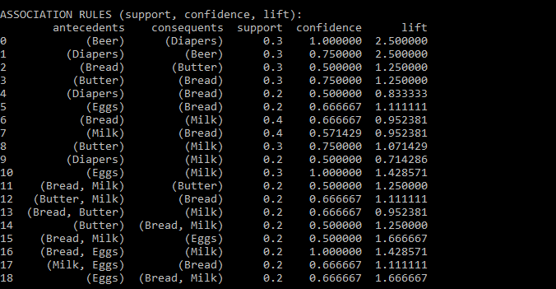
ASSOCIATION RULES

Slide 5

PART C: STRONGEST RULES

Slide 6
BUSINESS RECOMENDATIONS

